Slide 1


Rosemary Medige
29/08/2023

Slide 2

Outline
Executive Summary
Introduction
Methodology
Results
Conclusion
Appendix

Slide 3
Executive Summary
In this capstone project, we will predict if the Falcon 9 first stage will land successfully. If we can determine if the first stage will land, we can determine the cost of a launch. This will be achieved using different machine learning algorithms.
The Methodologies followed will include Data Collection, Data Wrangling, Exploratory Data Analysis, Data Visualization and Machine Learning.
During our investigation, the results of our analysis indicate that there are some features of rocket launches that have correlation with Success and Failure launches.
In the end we conclude that the Decision Tree may be the best Machine Learning algorithm for this problem.

Slide 4
Introduction
The main goal of this project is to predict if the Falcon 9 first stage will land successfully. SpaceX advertises Falcon 9 rocket launches on its website, with a cost of 62 million dollars; other providers cost upward of 165 million dollars each, much of the savings is because SpaceX can reuse the first stage. Therefore, if we can determine if the first stage will land, we can determine the cost of a launch. This information can be used if an alternate company wants to bid against SpaceX for a rocket launch.
This brings us to the main question that we are trying to answer: For a given set of features about a Falcon9 rocket launch, will the first stage of rocket land successfully?

Slide 5

Section 1

Slide 6
Methodology
Executive Summary
Data was collected through 2 methods: by requesting data from the SpaceX API and other way was web scraping launch data from Wikipedia.
Data wrangling was performed after data collection. By using Python’s Pandas library, we transform and clean the data.
Then we performed Exploratory Data analysis using Visualization tools such matplotlib and seaborn libraries. We also analyzed data using SQL queries. For Creating maps, we used Folium and for creating interactive data visualizations we used Plotly Dash.
We used four different Machine learning algorithms for predictive analysis. They are logistic regression, support vector machines, k-nearest neighbour and decision tree classifier. Each model was trained, tuned and evaluated to find the best one.

Slide 7
Data Collection
Request SpaceX launch data using Get Request method
GitHub link: DataCollection
Normalize JSON response into a dataframe
Extract only useful columns using auxiliary functions
Create new pandas dataframe from dictionary
Filter dataframe to include only Falcon 9 launches
Handle missing values
Export to CSV file

Slide 8
Data Collection - Scraping
Request Rocket launch data from its Wikipedia page
GitHub link: Webscraping
Extract all column/variable names from HTML table header
Create a dataframe by parsing the launch HTML tables
Export to CSV file

Slide 9
Data Wrangling
Calculate the number of launches on each site
GitHub link: Data Wrangling
Calculate the number and occurrence of each orbit
Calculate the number and occurrence of mission outcome per orbit type
Create a landing outcome label from Outcome column using one-hot encoding
Export to CSV
9

Slide 10
EDA with Data Visualization
Scatter plots: These are used to represent the relationship between two variables. Here using scatter plots, we compare different features such as Flight number vs launch site, Payload vs launch site, Flight number vs orbit type and Payload vs orbit type
Bar charts: These are used to make it easy to compare values between multiple groups at a time. Bar charts were used to compare the Success Rate for different Orbit types
Line charts: These are helpful for showing data trends over time. A line chart was used to show Success Rate over certain number of Years.
GitHub link:Data Visualization

Slide 11
EDA with SQL
SQL queries performed on the dataset are listed below:
Display the names of the unique launch sites in the space mission
Display 5 records where launch sites begin with the string 'CCA’
Display the total payload mass carried by boosters launched by NASA (CRS)
Display average payload mass carried by booster version F9 v1.1
To List the date when the first succesful landing outcome in ground pad was acheived.
To List the names of the boosters which have success in drone ship and have payload mass greater than 4000 but less than 6000
To List the total number of successful and failure mission outcomes
To List the names of the booster_versions which have carried the maximum payload mass. Use a subquery
To List the records which will display the month names, failure landing_outcomes in drone ship ,booster versions, launch_site for the months in year 2015.
Rank the count of landing outcomes (such as Failure (drone ship) or Success (ground pad)) between the date 2010-06-04 and 2017-03-20, in descending order.
GitHub link:
EDA with SQL

Slide 12
Build an Interactive Map with Folium
Objects were created and added to Folium map. Marker objects were used to show all launch sites on a map as well as the success/fail launches for each site on the map. Line objects were used to calculate the distances between a launch site and its proximities.
By adding these objects, following geographical patterns about launch sites are found:
Are launch sites in close proximity to railways? Yes
Are launch sites in close proximity to highways? Yes
Are launch sites in close proximity to coastline? Yes
Are launch sites kept away from cities? Yes
GitHub link: Interactive Map with Folium

Slide 13
Build a Dashboard with Plotly Dash
The Dashboard contains two charts:
A pie chart which shows successful launch by each site. This chart shows the distribution of landing outcomes across all launch sites or show the success rate of launches on individual sites.
A scatter chart shows the relationship between landing outcomes and payload mass of different boosters. The dashboard takes two inputs, sites and payload mass.
GitHub link: Dashboard

Slide 14
Predictive Analysis (Classification)
Create Column for Class
GitHub link:
Predictive Analysis
Standardize the data
Split into Training and Test set
Find best Hyperparameter for SVM, Decision trees, K-nearest neighbours and Logistic regression
Use test data to evaluate modules based on their accuracy scores and confusion matrix

Slide 15
Results
Exploratory data analysis results: The success rate of Falcon9 landings was 66%.
Predictive analysis results: The Decision tree algorithm was the best classification method with an accuracy of 88%

Slide 16

Section 2

Slide 17
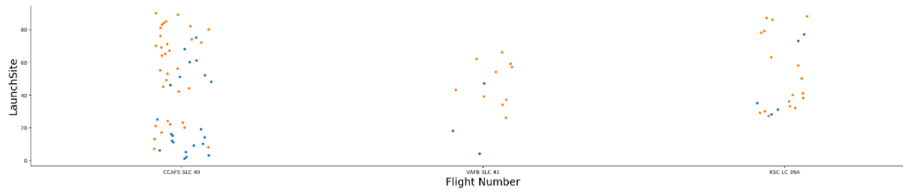
Flight Number vs. Launch Site
This figure shows that success rate increased as the number of flights increased

Slide 18
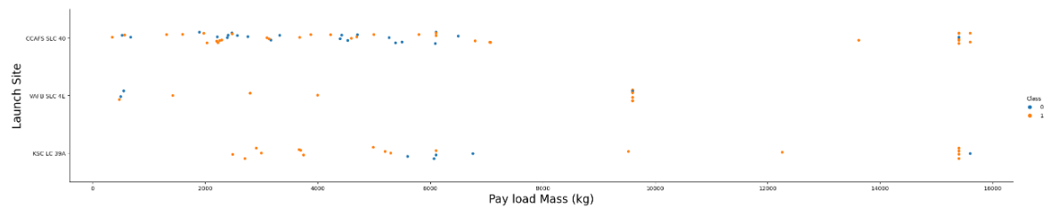
Payload vs. Launch Site
There seems to be weak correlation between payload and launch site and so decisions cannot be made using this.

Slide 19
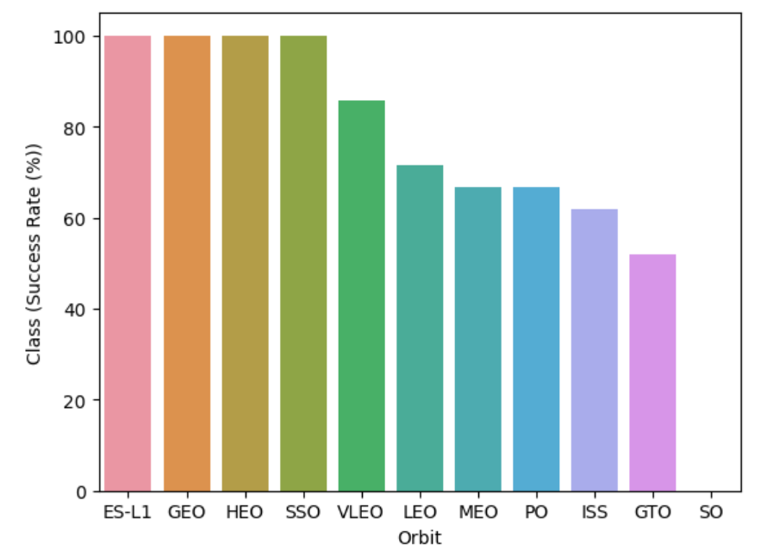
Success Rate vs. Orbit Type
Orbits ES-L1, GEO, HEO and SSO have 100% success rates.

Slide 20
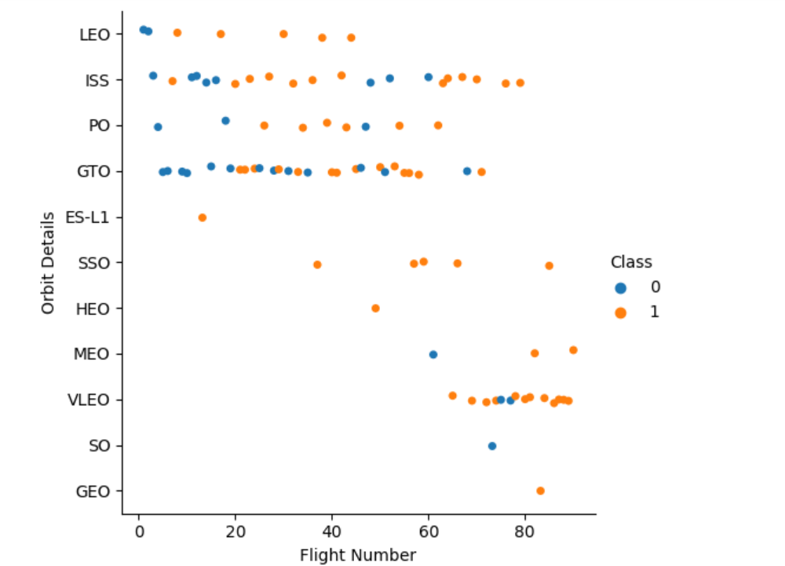
Flight Number vs. Orbit Type
There seems to be no correlation in GTO orbit
In LEO orbit, the success is positively correlated with number of flights
The SSO orbit has 100% success rate however with fewer flights than other orbits
Flight numbers greater than 40 have high success rate

Slide 21
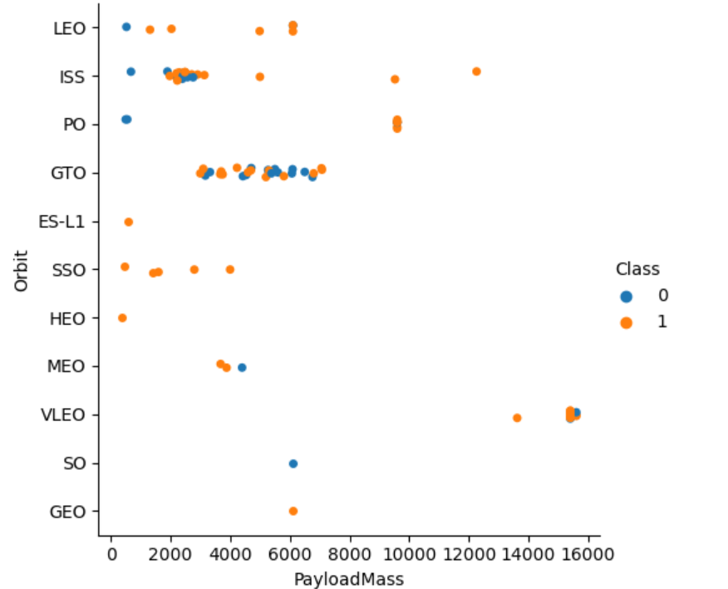
Payload vs. Orbit Type
There is no correlation in GTO orbit
In LEO orbit, the success is positively correlated with number of flights

Slide 22
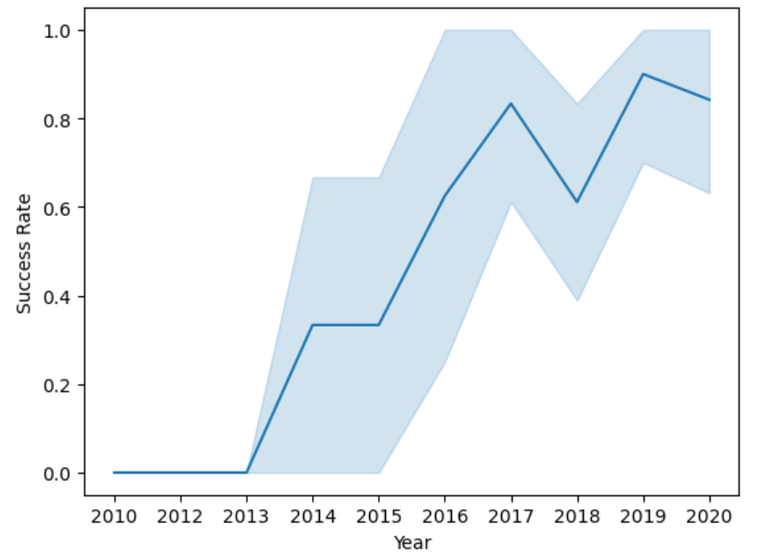
Year vs. Success Rate
The Success rate increased from 2013 and had its peak at 2019.

Slide 23
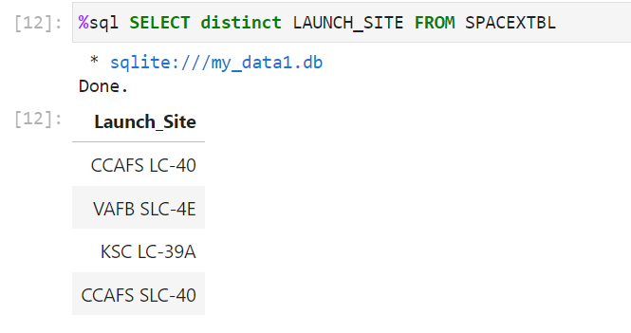
Unique Launch Sites in Space mission
These are the 4 Unique Launch sites in Space mission

Slide 24
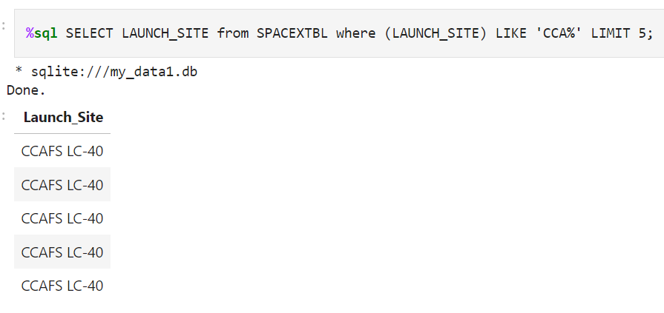
Launch Site Names Begin with 'CCA'
These are the 5 Launch sites that begins with ‘CCA’

Slide 25
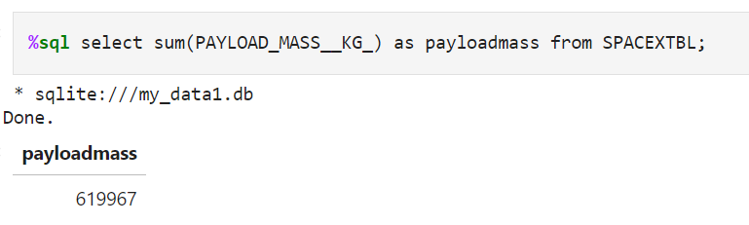
Total Payload Mass
The total payload carried by boosters from NASA is 619967

Slide 26
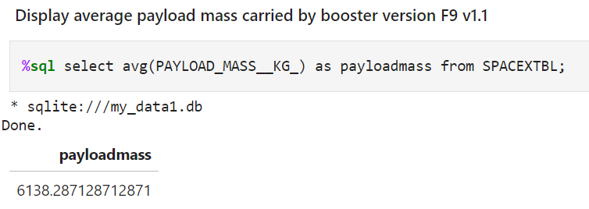
Average Payload Mass by F9 v1.1
The average payload mass carried by booster version F9 v1.1 is 6138.29 kg

Slide 27
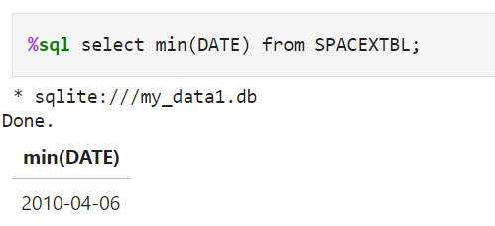
First Successful Ground Landing Date
The date of the first successful landing outcome on ground pad is 2010-04-06

Slide 28
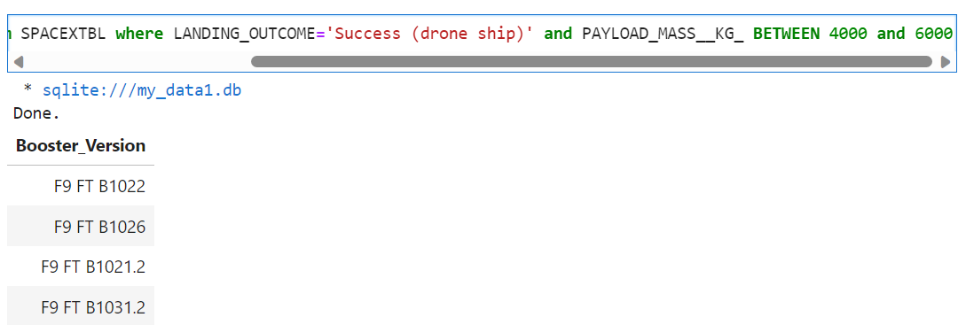
Names of the boosters which have success in drone ship and have payload mass greater than 4000 but less than 6000
%sql select BOOSTER_VERSION from SPACEXTBL where LANDING_OUTCOME='Success (drone ship)' and PAYLOAD_MASS__KG_ BETWEEN 4000 and 6000
There are 4 booster versions which qualifies above condition

Slide 29
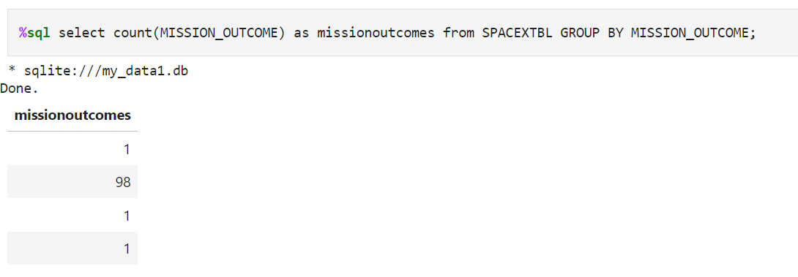
Total Number of Successful and Failure Mission Outcomes

Slide 30
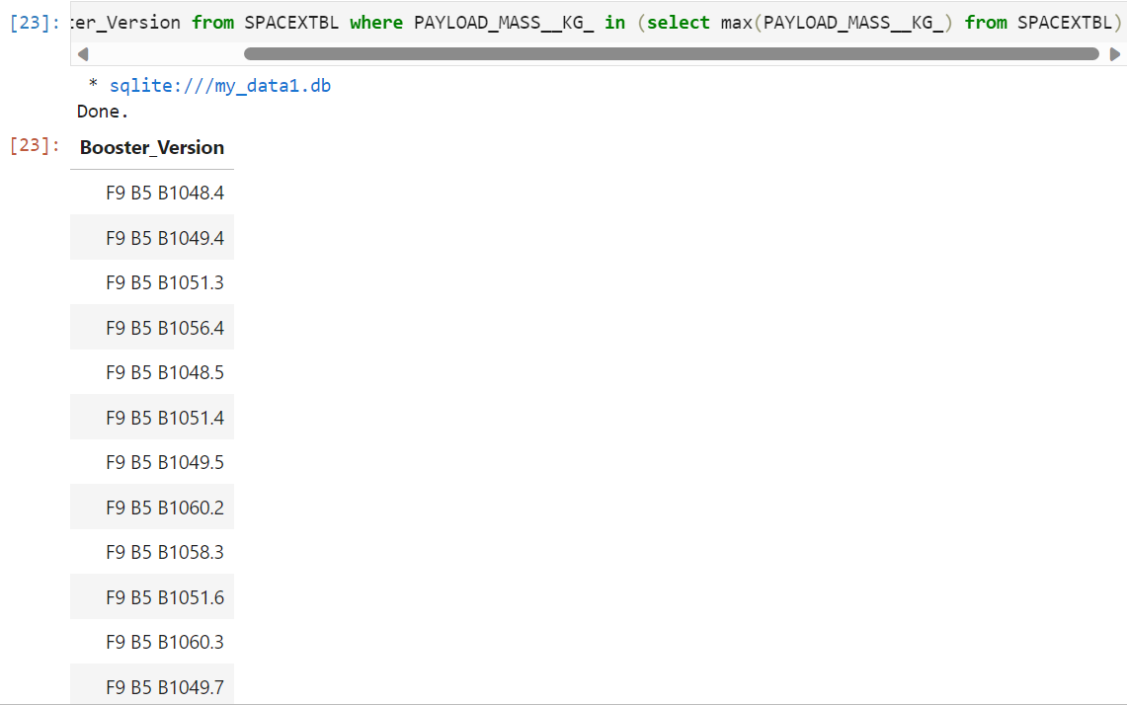
Names of the booster_versions which have carried the maximum payload mass
%sql select Booster_Version from SPACEXTBL where PAYLOAD_MASS__KG_ in (select max(PAYLOAD_MASS__KG_) from SPACEXTBL)

Slide 31
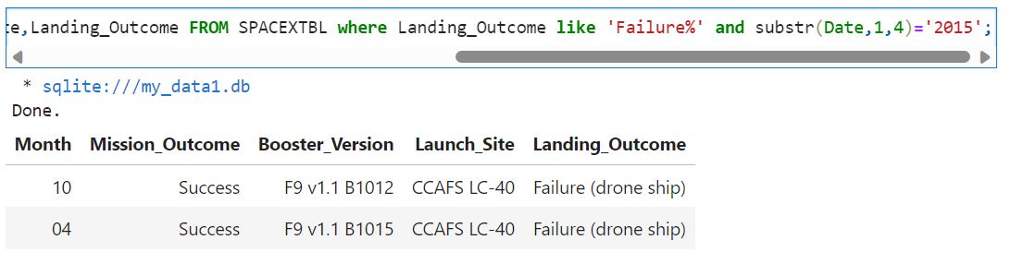
Records which will display the month names, failure landing_outcomes in drone ship ,booster versions, launch_site for the months in year 2015
%sql SELECT substr(Date, 6, 2) as Month,Mission_Outcome,Booster_Version,Launch_Site,Landing_Outcome FROM SPACEXTBL where Landing_Outcome like 'Failure%' and substr(Date,1,4)='2015’;

Slide 32
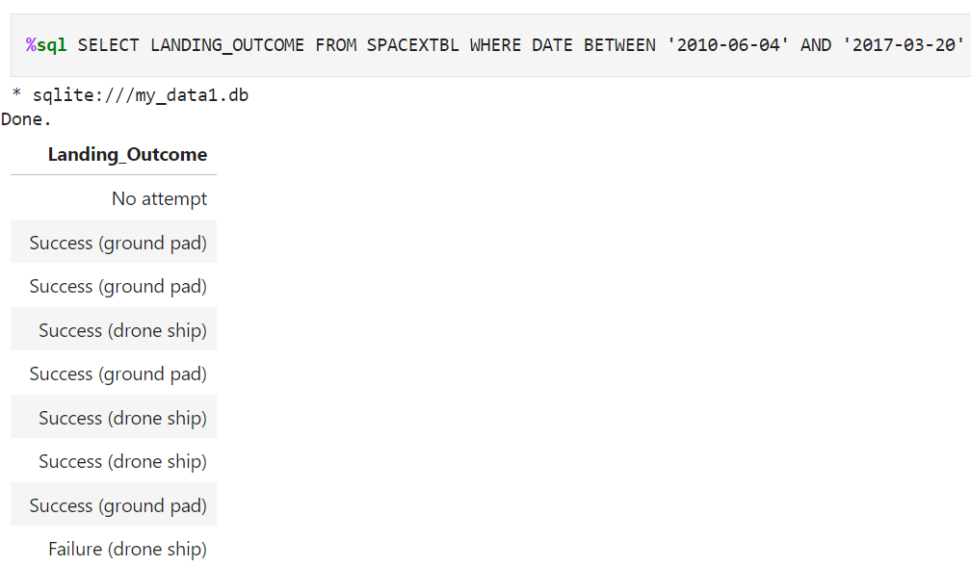
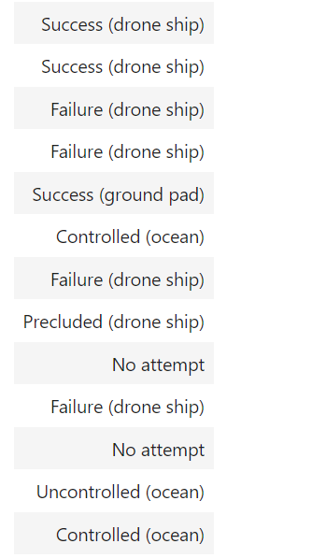
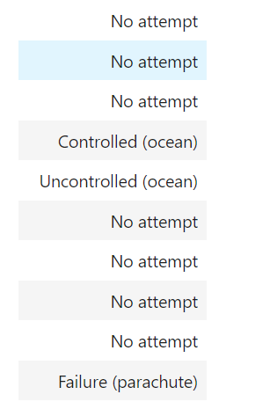
Rank Landing Outcomes Between 2010-06-04 and 2017-03-20

Slide 33

Section 3

Slide 34
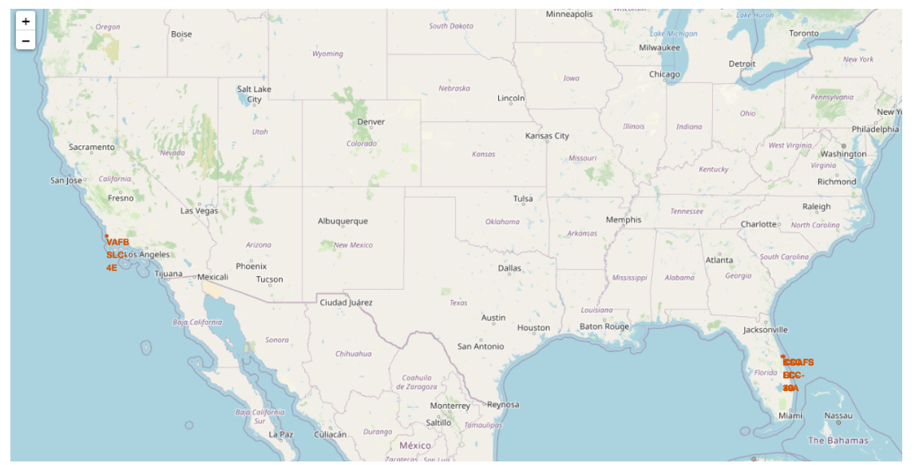
Folium Map 1

Slide 35
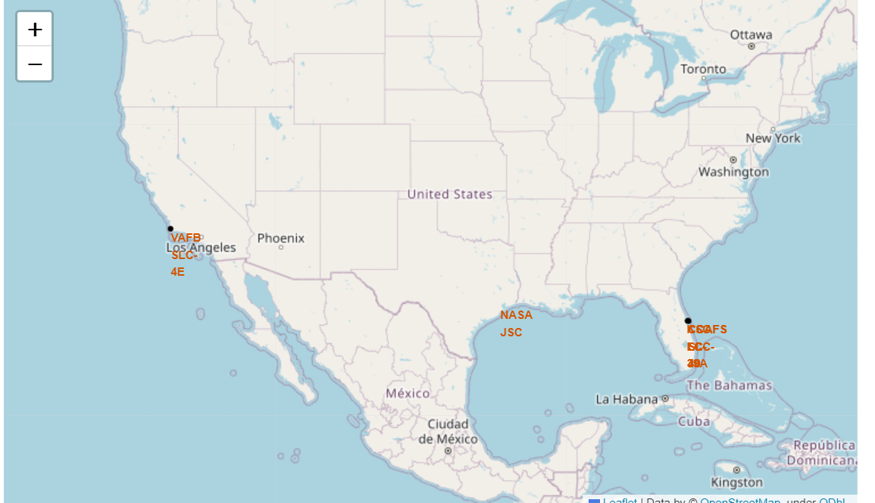
Folium Map 2

Slide 36
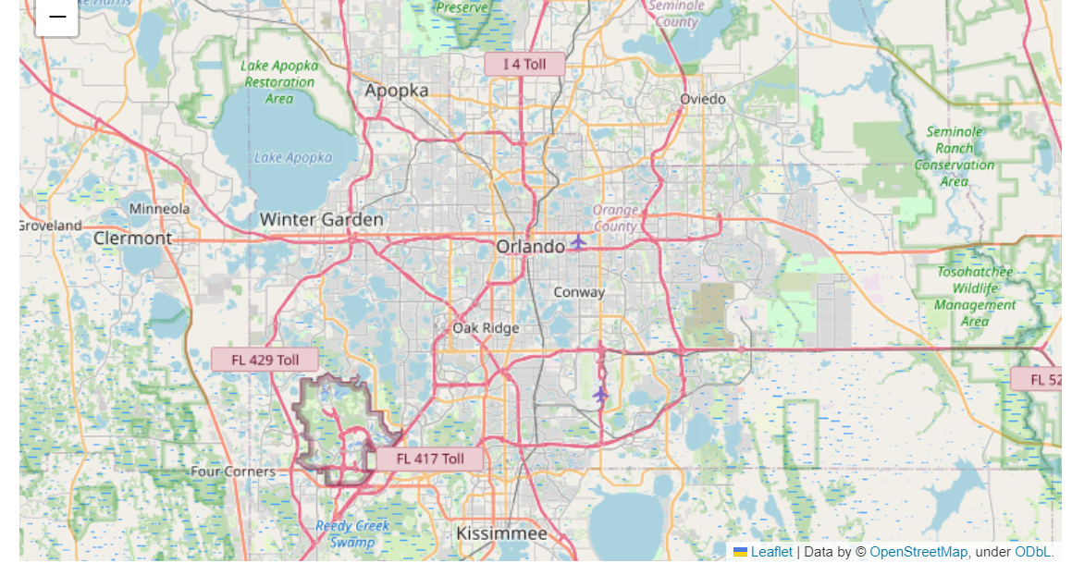
Folium Map 3

Slide 37

Section 5

Slide 38
Classification Accuracy
At the end, we found Classification Accuracy for different models as below:
1. Logistic Regression test data accuracy: 0.83333%
2. SVM test data accuracy: 0.84821%
3. Decision tree data accuracy: 0.88928%
4. K-neighbours data accuracy: 0.848215%

Slide 39
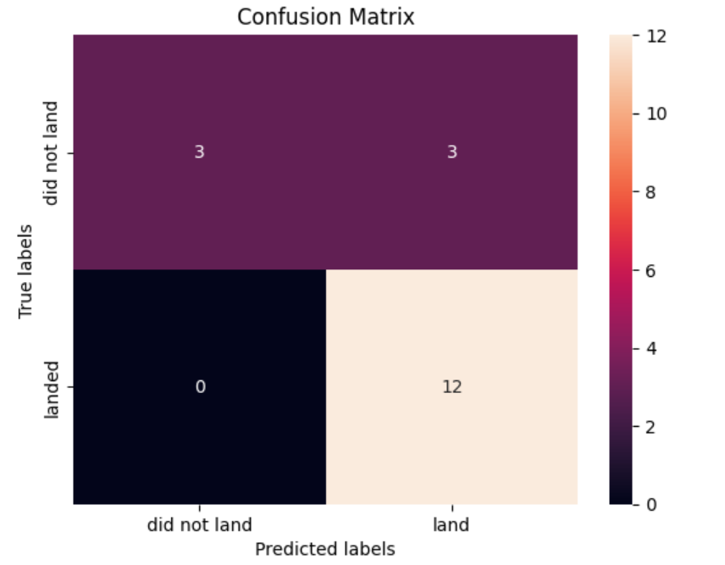
Confusion Matrix
This is the confusion matrix of Decision tree.
As we see Decision tree method have highest test data accuracy, i.e, 88.9% we consider this as the best performing model.

Slide 40
Conclusions
To Summarize, we identify the problem that we need to predict if the Falcon 9 first stage will land successfully.
Then we collected the data using Webscraping and SpaceX URL.
We preprocessed and analyzed data using Exploratory data analysis and SQL queries.
We trained and tested using different Machine learning algorithms.
Finally, we concluded that Decision tree is the best model for this problem.
Hence with 88% Success accuracy, we can conclude that Falcon 9 first stage will land successfully.

Slide 41


